Slide 1


Shubhangi Mule UCS23F1087
Aditya Munde UCS23M1088
Yash Nannaware UCS23M1093
Atharva Narkhede UCS23M1094

Slide 2


Slide 3
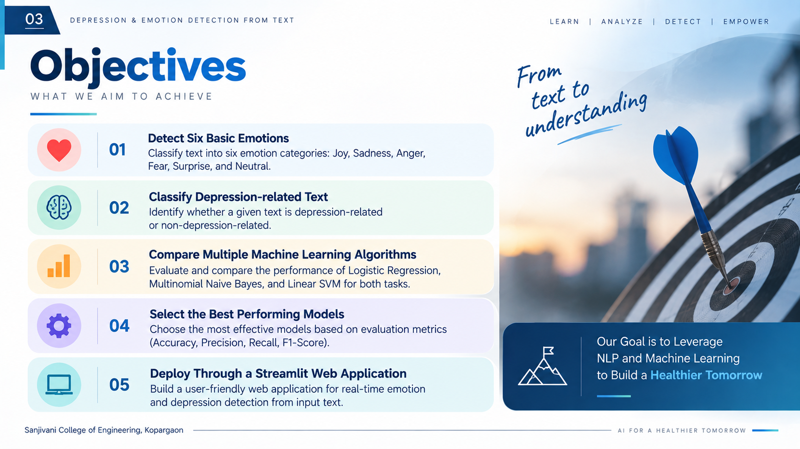

Slide 4
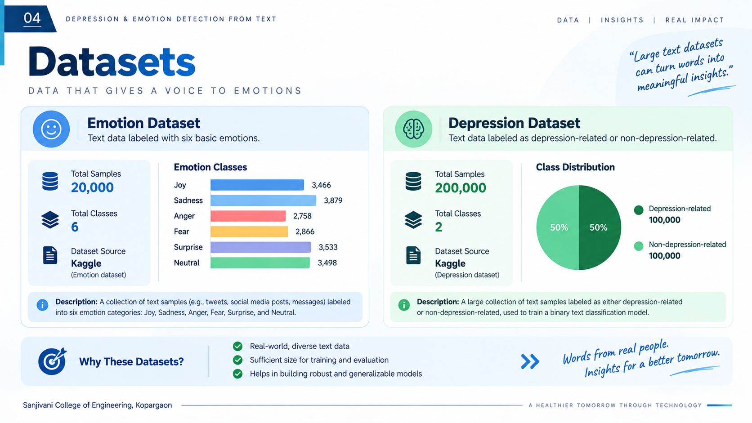

Slide 5
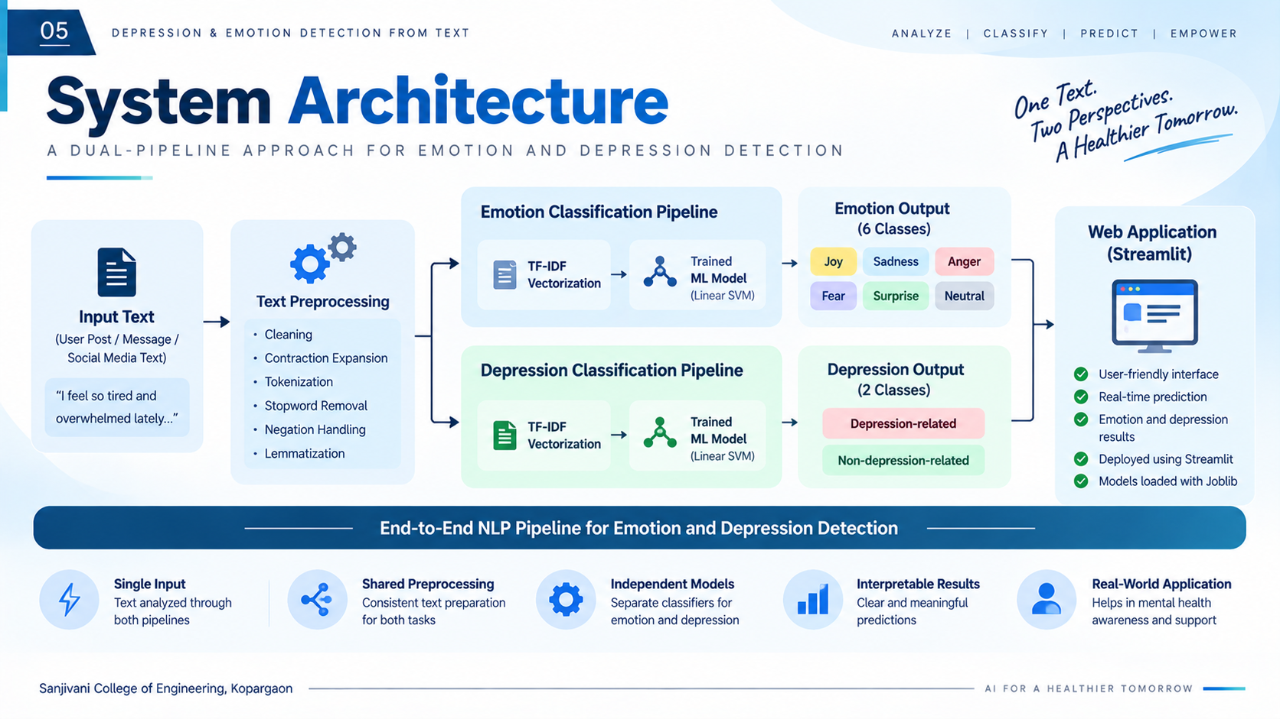

Slide 6


Slide 7
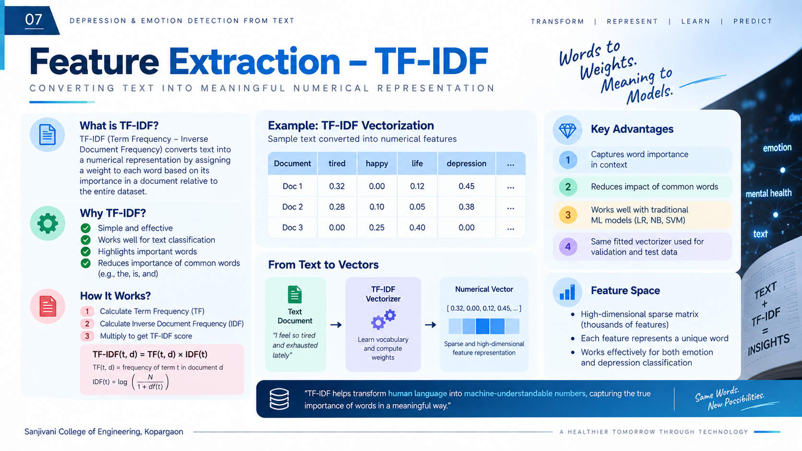

Slide 8
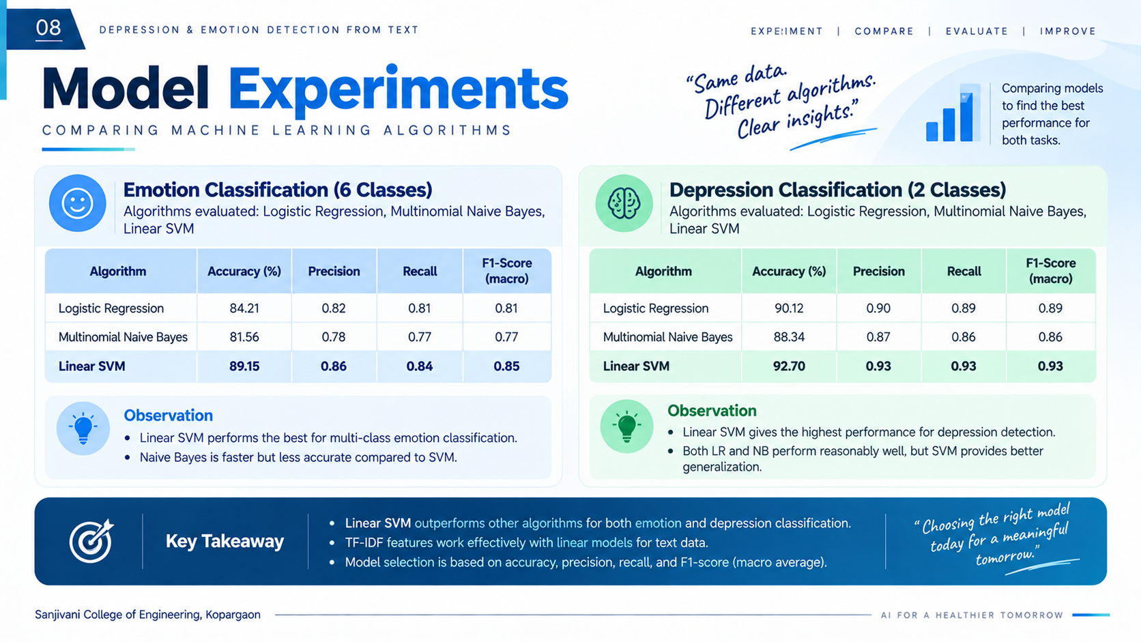

Slide 9


Slide 10


Slide 11


Slide 12


